Slide 1
The Effect of Gun Violence Legislation in the Wake of Sandy Hook
Davis DeRodes

Slide 2

Background
Sandy Hook Elementary Shooting occurs on December 12, 2012
1,500 bills involving guns are introduced at the state level in 2013
109 of these bills became law

Slide 3
How does state level gun legislation affect deaths by firearms in the US?

Slide 4
Hypotheses
Pro-Gun Hypotheses
Anti-Gun Hypotheses
Pro-gun laws should deter crime due to “good guys” having guns
Laws should increase access to guns and places where to use guns
Systematically disproved by the literature
Anti-gun laws should deter crime due to less guns existing
Pro-gun laws should increase crime due to more guns existing
Systematically proved by the literature

Slide 5
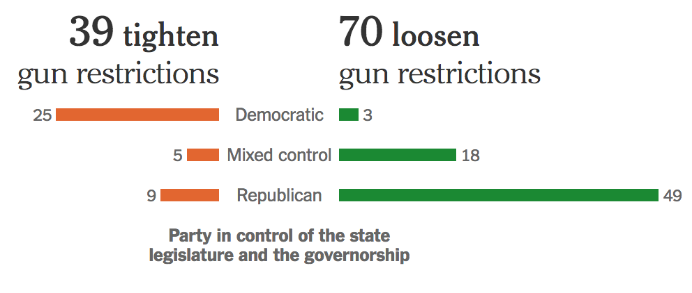
Data
Death rates of all causes by state are published by the CDC annually
Deaths by firearm per 100,000 citizens
2012-2015
NY Times published a data infographic entitled - “State Gun Laws Enacted in the Year After Newtown”
Dummy variables were created for each state for whether or not the passed a certain type of law
The National Conference on the State Legislature has Data on Party Control
Dummy variables were created for each state for party in control in legislature, governorship, and state politics as a whole

Slide 6
Types of Gun Laws
Pro-Gun Laws - Republican
Anti-Gun Laws - Democrat
PGP - Pro Gun Permit
PPC - Pro Public Carry
PS - Pro Guns in School
AM - Anti Mental Health Restrictions
ABC - Anti Background Checks
AAR - Anti Assault Weapon Restriction
LGA - Loosen Gun Access
NFL - Nullify Federal Law
AGP - Anti Gun Permit
PM - Pro Mental Health Restrictions
PBC - Pro Background Checks
PAR - Pro Assault Weapon Restriction
TGA - Tighter Gun Access
LSG - Lost or Stolen Guns Restriction

Slide 7
Problems with the Data
States with non-divided governments were more likely to pass laws.
Counterfactuals are difficult to find (ie: states that were divided that passed laws and states that weren’t divided that didn’t pass laws).
Confident that there’s an unobserved fixed effect (ie: “gun-culture”).
Republican status of states should control this to some degree, but there probably are more.
Some types of laws weren’t passed that many times.
They effectively become dummy variables for certain states.

Slide 8
Analysis
Fixed Effects Models

Slide 9
Why Fixed Effects?
Very hard to argue that unobserved fixed effects are not correlated
Random effects model is very similar to fixed effects model
First difference model is difficult to create and serial correlation is probably is not a massive issue

Slide 10
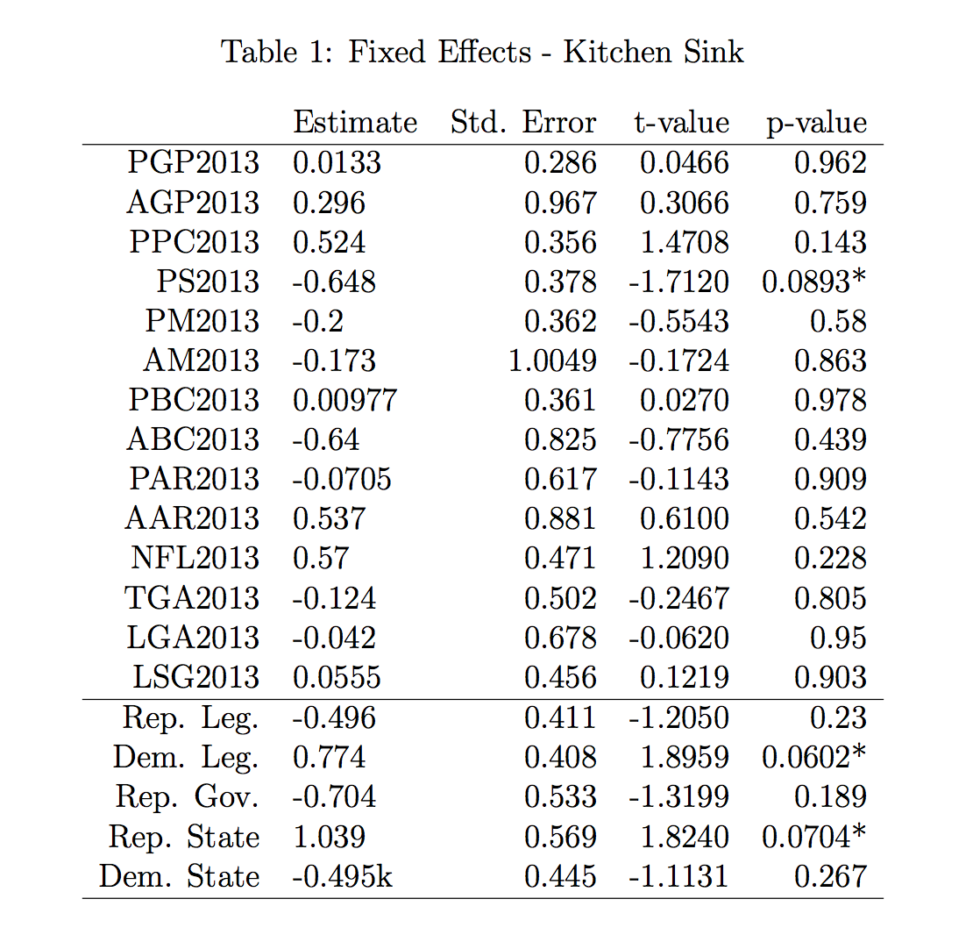
“Kitchen Sink” Fixed Effects Model
Pro: Includes all of the laws
Pro: Largest Robust R-Squared
Con: Some of the laws don’t have enough observations
Con: Not parsimonious

Slide 11
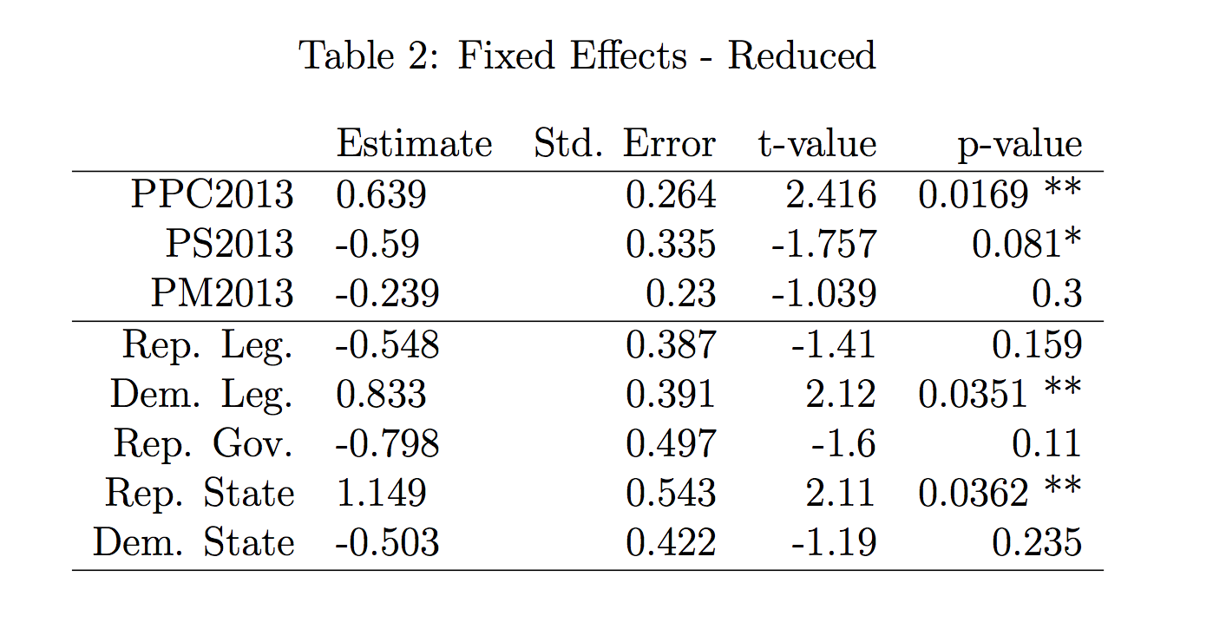
”Reduced” Fixed Effects Model
Pro: Parsimonious
Pro: Includes the laws that “Matter”
Pro: Includes only laws with sufficient observations
Con: Lower R-Squared
Problem: Estimate on PS2013 doesn’t make sense

Slide 12
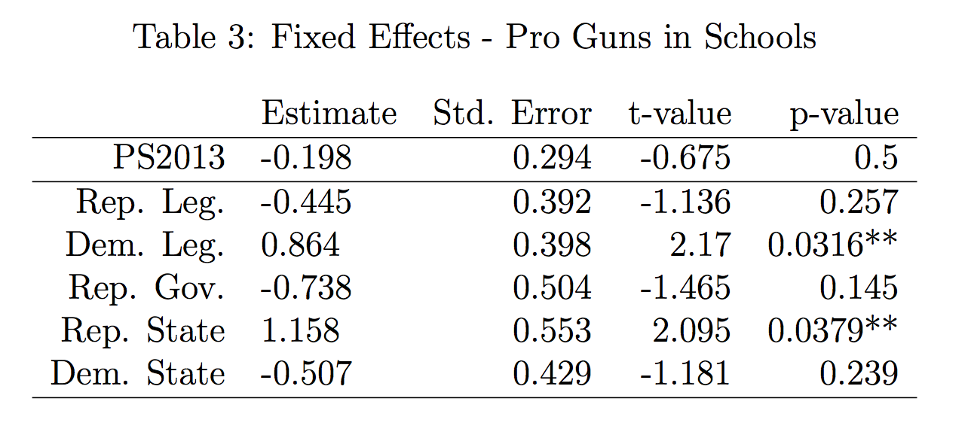
Guns in Schools
Every state except for Indiana passed a PPC law
Every state that passed a PPC law and a PS law had an increase in gun violence or no effect
Indiana had a decrease in gun violence

Slide 13
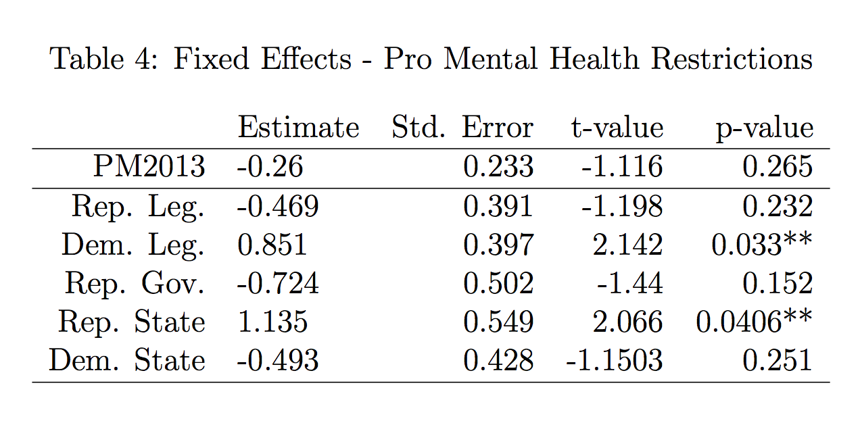
Mental Health Restrictions
Mental Health on the other side was nearly significant and has very little correlation with PPC
Still not significant, but fairly robust

Slide 14
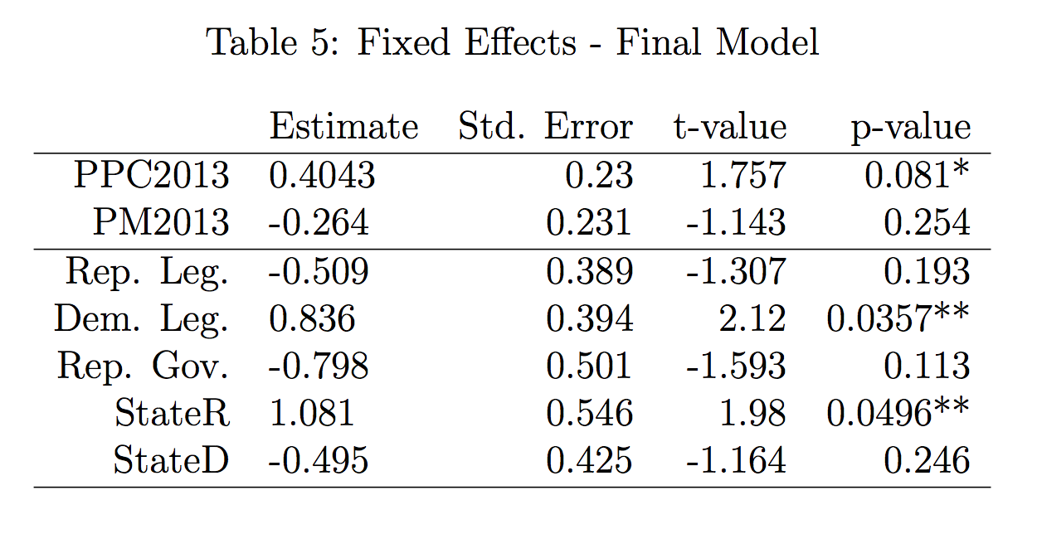
Final Model
States with a Pro Public Carry Law have an expected increase of .4 deaths by fire arms per 100,000 citizens.
Although this doesn’t sound like a lot in the state of Georgia (population: 42.5 million) that’s a predicted extra 17 people dying each year due to fire arms.

